Slide 1







Sentiment Analysis on Amazon Reviews of Cellphones and Accessories
Presented By
Krishitha Akula
UMBC

Slide 2
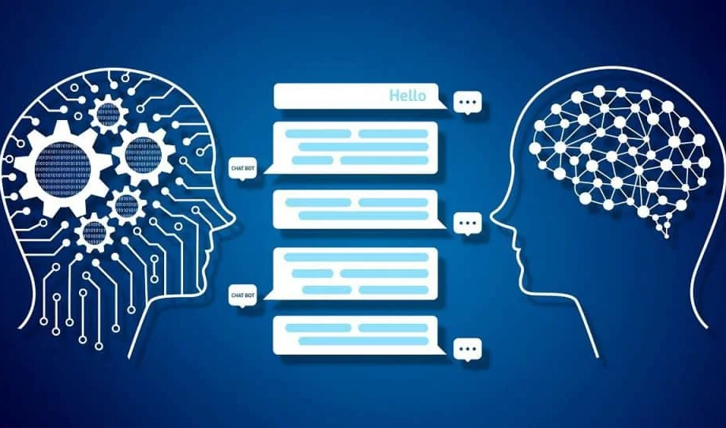

Introduction
Humans ourselves are not able to understand how exactly language is processed by our brains. So, is it possible for us to teach a machine to learn our language??
Yes, NLP or Natural Language Processing is sentiment analysis i.e., field of study that focuses on the interactions between human language and computers, that classifies a statement as positive or negative
UMBC

Slide 3

Overview
In this project I have predicted the sentiment based of the review.
I have acquired the dataset from link.
I discovered several insights from the data while working towards our goal.
I have extracted the insights from data and used various classification algorithms to predict the sentiment based of the review.
UMBC

Slide 4
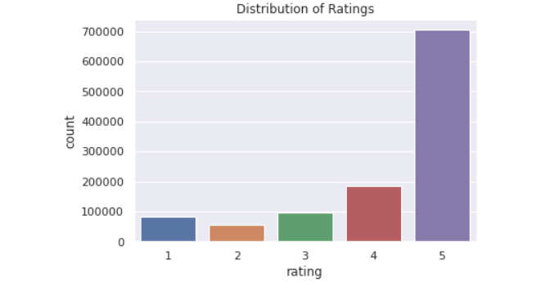
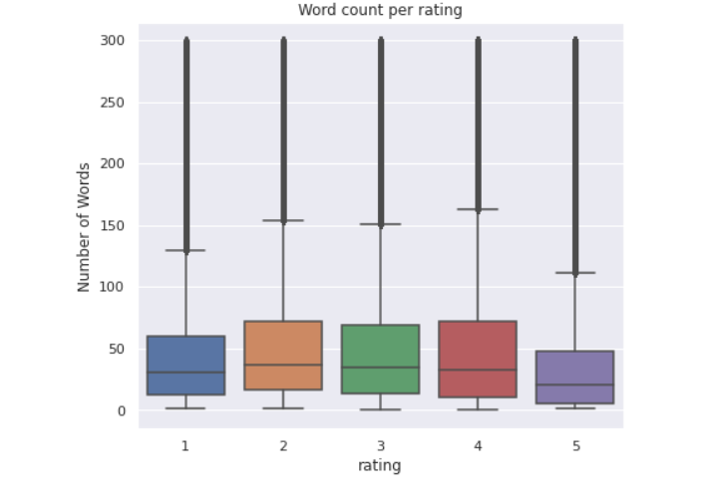
INSIGHTS
We see that there are many positive reviews i.e., reviews with ratings 4 and 5
We see that reviews with rating 5 tend to be smaller than other reviews
UMBC

Slide 5
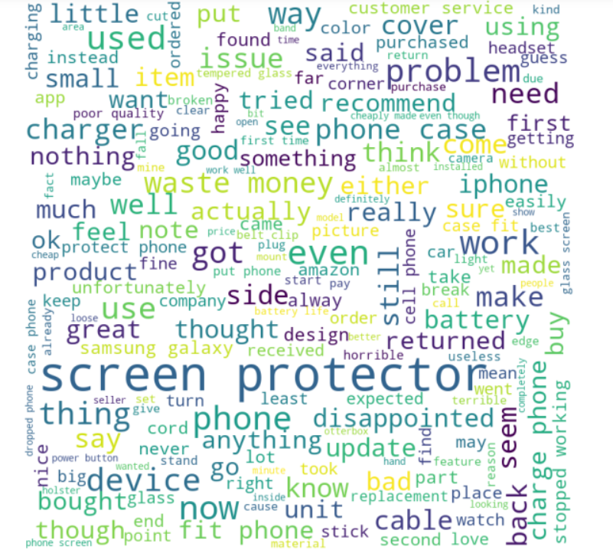
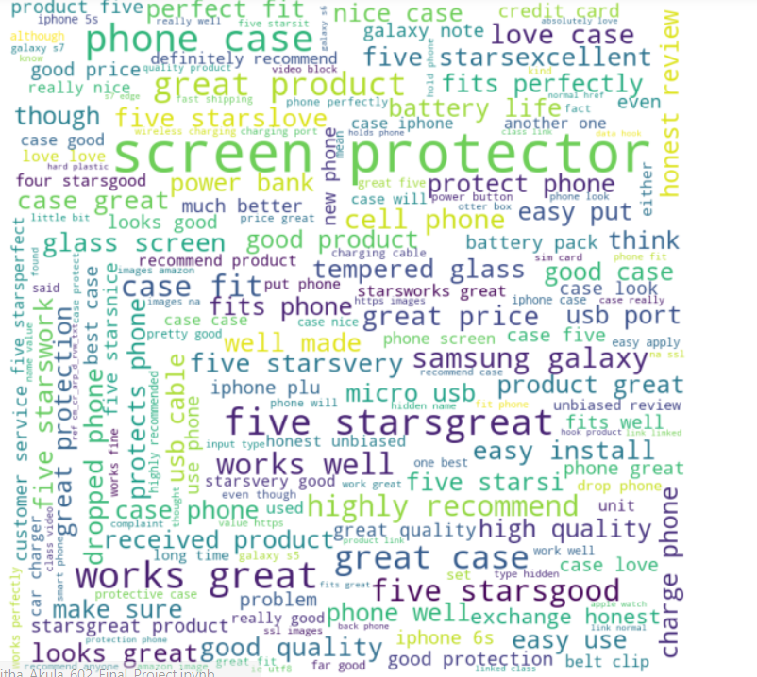
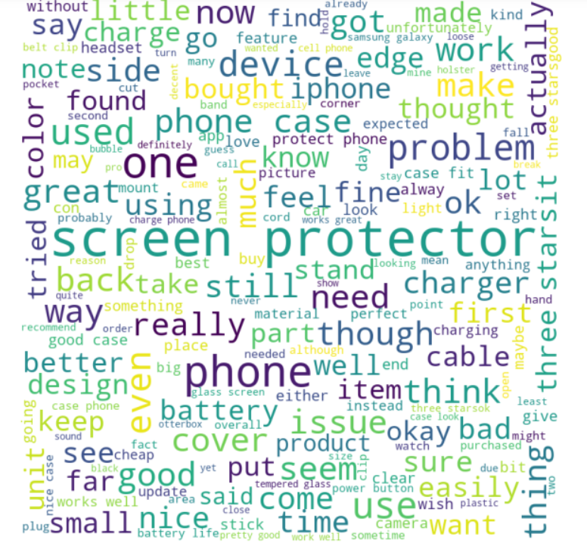
INSIGHTS
Observation:
We find both positive words like good, nice, better, etc. and negative words like bad, problem
Observation:
We can find few –ve words like disappinted, problem, issue, etc
Observation:
We can find few +ve words like great, perfect, works well, good quality
UMBC

Slide 6
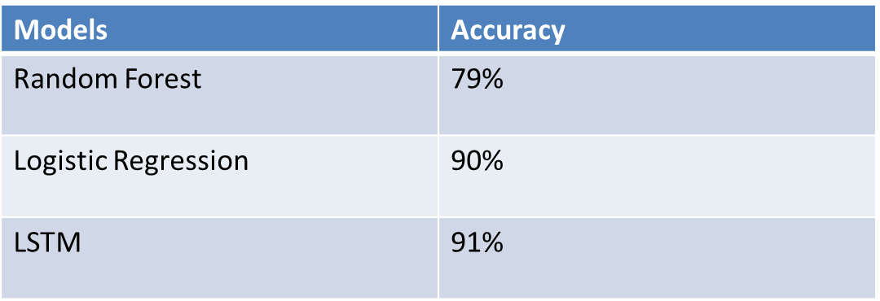
Implementing Machine Learning Models
I have chosen random forest as it is a powerful classifier, but it was classifying everything as class 5. It was doing a very poor job
Later I decided to use Logistic Regression as it is a basic classification algorithm and surprisingly it gave a very good accuracy of 90%
I wanted to use LSTM as it is a sequential algorithm and as we were working on sequential data(In a sentence one word is linked to another) I thought LSTM would perform well. It gave 91% accuracy
UMBC

Slide 7
However, sentiment analysis will develop deeper in the future, beyond the concept of positive, negative, or neutral, to reach and comprehend the significance of understanding conversations and what they reveal about consumers. Based on that data the companies can better serve the users with much better recommendation of products.
Further Exploration
UMBC

Slide 8
References
https://www.geeksforgeeks.org/generating-word-cloud-python/
https://github.com/bertcarremans/TwitterUSAirlineSentiment/blob/master/source/Using%20Word%20Embeddings%20for%20Sentiment%20Analysis.ipynb
https://machinelearningmastery.com/save-load-keras-deep-learning-models/
http://www.datasciencemadesimple.com/convert-column-to-categorical-pandas-python-2/
Reference: https://towardsdatascience.com/hyperparameter-tuning-the-random-forest-in-python-using-scikit-learn-28d2aa77dd74
UMBC

Slide 9

UMBC

